Slide 1
ARDUINO AND MICROCONTROLLERS
Fabrizio Manzino
Mechatronics Lab
Sissa

Slide 2
Arduino Language
If you want to change the IDE theme :
1) Download: https://github.com/jeffThompson/DarkArduinoTheme
2) Replace the «theme» folder in C:\Program Files (x86)\Arduino\lib (rename the original “theme” folder so that you can roll back)

Slide 3
Arduino Language
The C programming language began its march to become formally defined by the American National Standard Institute (ANSI) with the formation of the X3J11 committee in 1983. The committee’s work was completed and the standard passed in 1989. Since then, the language is often referred to an “ANSI C”.

Slide 4
Arduino Language
The C you are about to learn is not standard C. Rather, you will be learning a robust subset of standard C. A few standard C features are missing. But the absence of those features is not a crippling blow by any means. You will soon discover that the subset version of standard C, which we will call Arduino C, is more than able to perform just about any task you can throw at it.

Slide 5
Arduino Language
Where to start from?

Slide 6
Arduino Language
All programming languages are built from four basic elements:
1. Expressions 2. Statements 3. Statement blocks 4. Function blocks

Slide 7
Arduino Language
What’s an expression:
An expression is created by combining operands and operators. Simply stated, an operand is typically a piece of data that is acted on by an operator. An operator is often a mathematical or logical action that is performed on one or more operands. For example:
22 a + b m – 3000 g < d

Slide 8
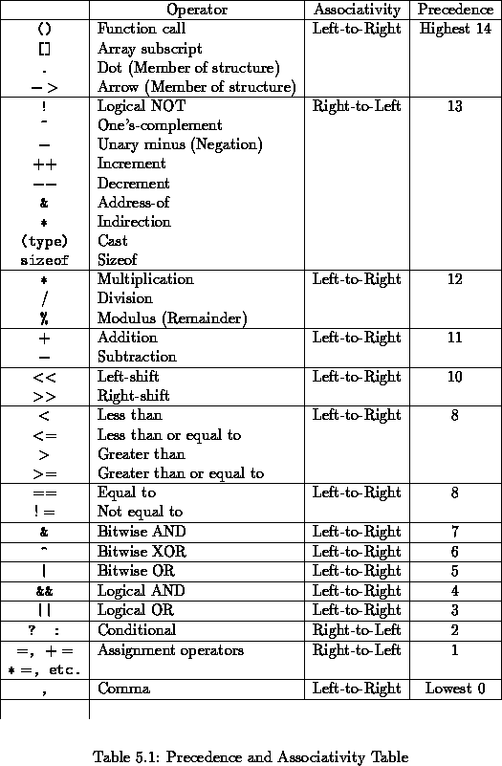
Arduino Language
Operator precedence

Slide 9
Arduino Language
What’s a statement:
A statement is a complete C instruction for the computer. All C statements end with a semicolon (;). The following are examples of C statements:
i = 50; a = b + c; m = d / 2;

Slide 10
Arduino Language
What’s a statement block:
A statement block consists of one or more statements grouped together so they are viewed by the compiler as though they are a single statement. For example, suppose you are an apartment manager, and if there is 4 or more inches of snow on the ground, then you need to shovel the sidewalk. You might express this as :
if (snow >= 4) { PutOnSnowRemovalStuff(); GetSnowShovel(); ShovelSidewalk();
} else { GoBackToBed(); }
Statement blocks start with an opening brace character { and end with a closing brace character }. All statements between the opening and closing braces form the statement block body.

Slide 11
Arduino Language
What’s a function:
A function block is a block of code that is designed to accomplish a single task. Although you may not be aware of it, you actually used a function block in the previous section. That is, PutOnSnowRemovalStuff() is a function that is designed to have you put on your coat. The actual code might look like:
void PutOnSnowRemovalStuff(void) { if (NotDressed) { PutOnClothes(); PutOnShoes(); } GoToCloset(); PutOnBoots(); PutOnCoat(); PutOnGloves(); PutOnHat(); }
However, function blocks are usually written to create “black boxes” in which the details of how we are doing something are buried in the function

Slide 12
Arduino Language
What is a variable?
Simply stated, a variable is nothing more than a location in memory that has been assigned a name.

Slide 13
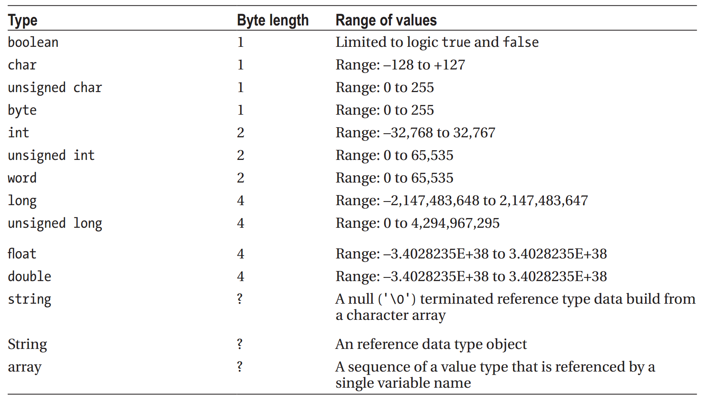
Arduino Language
Type of Data

Slide 14
Arduino Language
The boolean Data Type:
The boolean data type is limited to two values or states: true or false. These two values are constants that are defned within the compiler and are the only two values a boolean variable can assume. Therefore, the following is a valid defnition for a boolean variable:
boolean mySwitch = false;

Slide 15
Arduino Language
The char Data Type
The char data type is used to store a single character as an 8-bit quantity. This includes both the signed and unsigned char data type. In all Arduino C data types, if the sign bit (the highest bit in the data type) is 1, then the interpretation is that the value is negative.

Slide 16
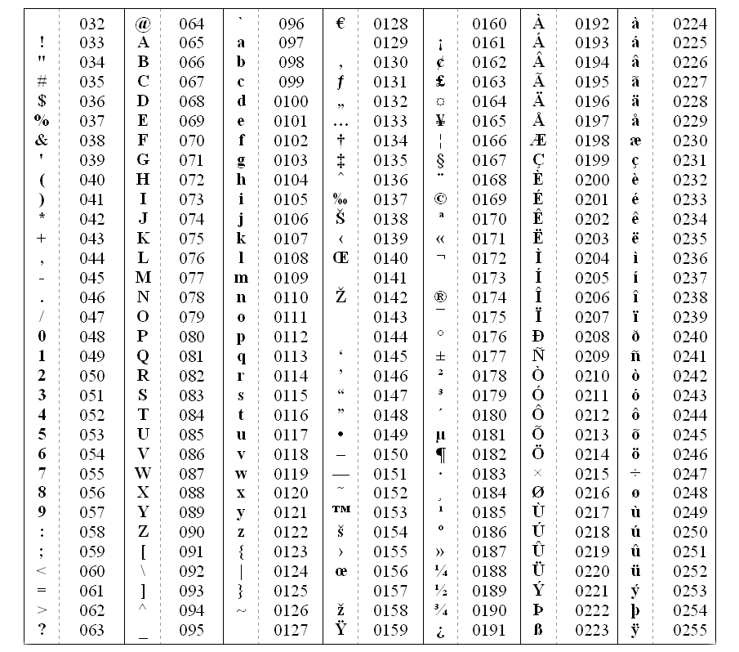
Arduino Language
Ascii table

Slide 17
Arduino Language
The byte Data Type
The byte data type is also an 8-bit value, but there is no sign bit, so its range is almost twice that of a char. You may use the byte data type to store any value between 0 and 255. If you ever find yourself in a situation where you are running out of memory for data storage, then changing the data from an int data type to a byte might save
the day.

Slide 18
Arduino Language
The int Data Type
The int data type is an integer value in C and is a signed quantity. Because an int is a signed quantity, an int can assume either positive or negative whole numbers.
Fractional values are not allowed for any integer data types. If a math operation with integer values yields a fractional value (e.g., 5 / 4), then that fractional value is truncated and only the whole number is retained (i.e., the result is 1, not 1.25).

Slide 19
Arduino Language
The int Data Type
In Arduino C, an int data type is a 16-bit value, as shown in Table 3-1. In some other languages (e.g., Java, C#, C++), an int is usually a 32-bit (4 byte) entity. If you have programmed before in some of these other languages, then you need to be aware that an int in Arduino C has a smaller numeric range than it carries in other programming languages.

Slide 20
Arduino Language
The word Data Type
The word data type has the same storage requirements and range of values as an unsigned int.

Slide 21
Arduino Language
The long Data type
Because the long data type uses 32 bits (4 bytes), it has an approximate range of values of between plus or minus 2 billion. Like the other data types discussed so far, the long data type is also an integer data type and, as such, cannot be used to represent fractional values.

Slide 22
Arduino Language
The ﬂoat and double Data Types
Arduino C does allow ﬂoating point numbers. That is, you can have data values in your program that use fractional values.
The range of values for a ﬂoat is roughly plus or minus 3.4 to the 38th power. That’s a big number: A value with up to 38 digits. Each ﬂoat requires 4 bytes of storage space.

Slide 23
Arduino Language
The string Data Type
A string is a sequence of ASCII characters treated as a single entity. In other words, it is a string of characters. The string data type may be implemented several different ways.

Slide 24
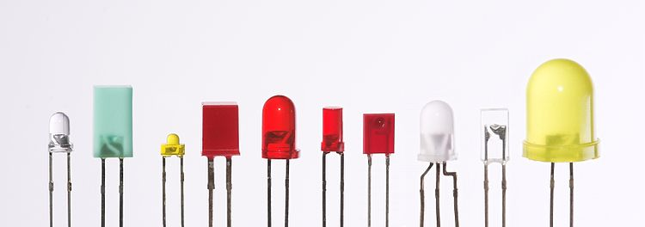
Arduino basic tools
The led
Stands for "Light-Emitting Diode." An LED is an electronic device that emits light when an electrical current is passed through it

Slide 25
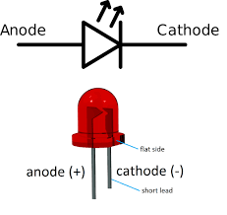
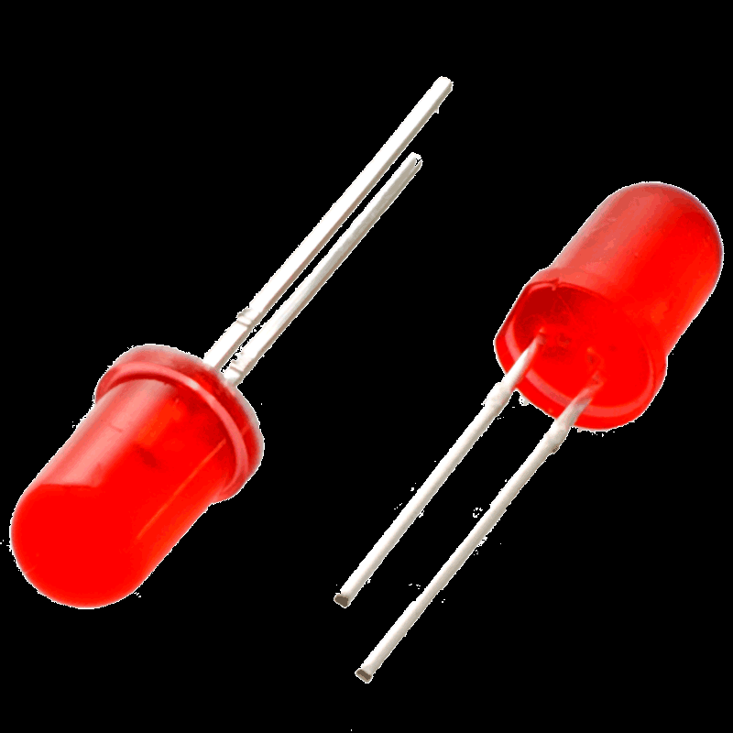
Arduino basic tools
The led
Current can pass in one direction, but is blocked in the other

Slide 26
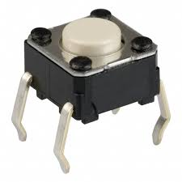
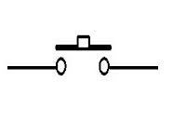
Arduino basic tools
The button
In electronics, an electronic switch is an electronic component or device that can switch an electrical circuit, interrupting the current or diverting it from one conductor to another

Slide 27
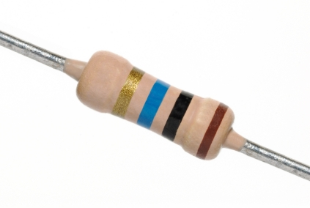
Arduino basic tools
The resistor
A resistor is an electrical component that limits or regulates the flow of electrical current in an electronic circuit.

Slide 28
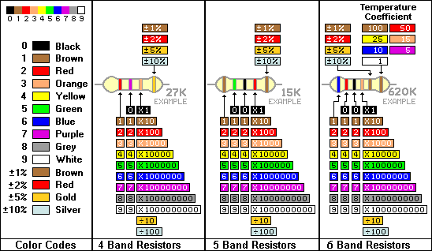
Arduino basic tools
The resistor

Slide 29
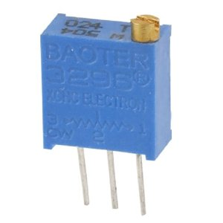
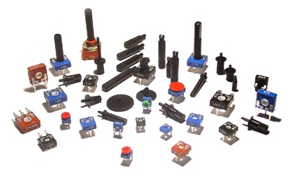
Arduino basic tools
The trimmer
The trimmer is a resistor with a variable value.

Slide 30
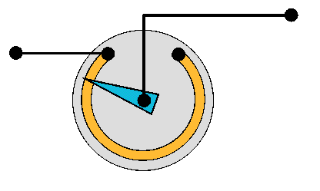
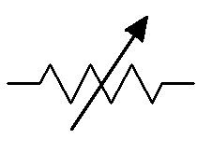
Arduino basic tools
The trimmer
Notes:
Esempio del partitore di tensione a partire dalla legge di ohm

Slide 31
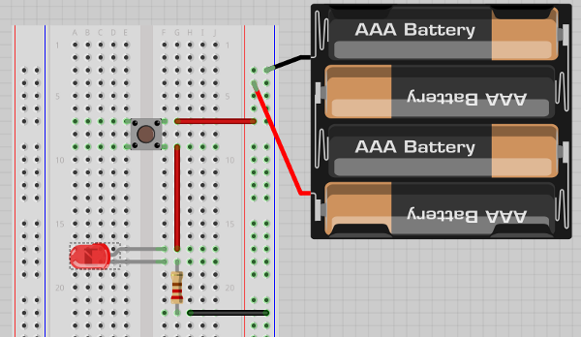
Arduino basic tools
Electronic circuit
An electronic circuit is a combination of electronics elements.

Slide 32
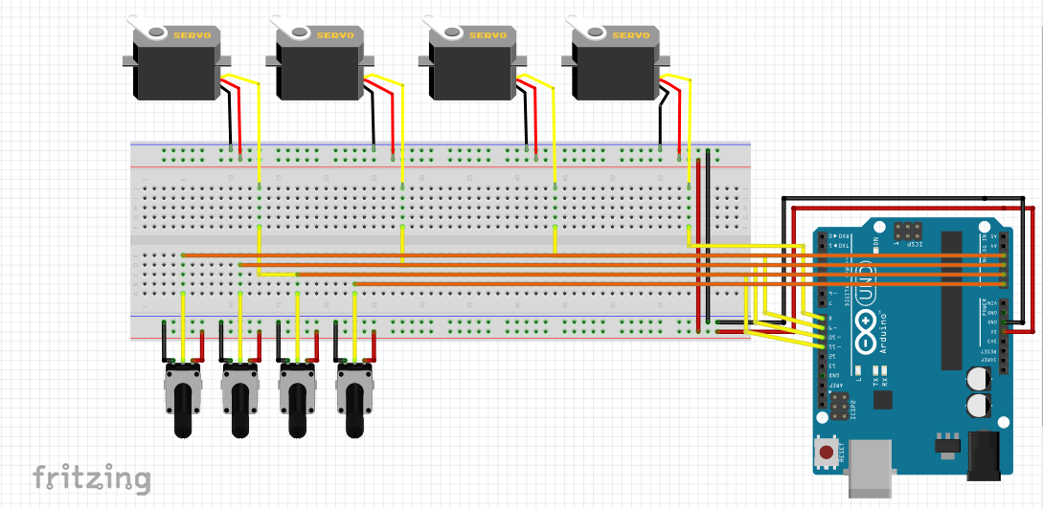
Arduino basic tools
A nice tool :
http://fritzing.org/home/

Slide 33
Arduino Language
The if Statement
In a computer program, unless the central processing unit (CPU) is told to do otherwise, the CPU processes the source code program instructions in a linear, top-to-bottom manner. That is, program execution starts at whatever is designated as the starting point for the program and plows through the source code from that point to the next statement until all of the statements have been processed.

Slide 34
Arduino Language
The if Statement
You can, however, alter this linear processing ﬂow by using an if statement. The syntax for an if statement is:
If (expression1 is logic true) {
// execute this if statement block if true
}
// statements following the if statement block

Slide 35
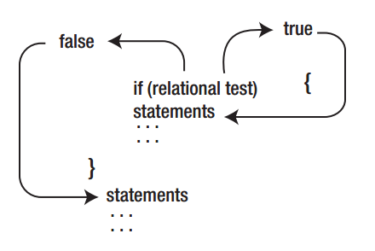
Arduino Language
The if Statement

Slide 36
Arduino Language
The if-else Statement
C provides another form of the simple if statement called the if-else statement. The syntax for the if else statement is:
if (expression evaluates to logic true) {
// perform this statement block if logic true
} else {
// perform this statement block otherwise
}

Slide 37
Arduino Language
The switch Statement
The switch statement has the following syntax:
switch (expression1) { // opening brace for switch statement block
case 1:
// statements to execute when expression1 is 1
break;
case 2:
// statements to execute when expression1 is 2
break;
case 3:
// statements to execute when expression1 is 3
break;
// more case statements as needed
default:
// statements to execute if expression1 doesn't have a "case value"
break;
} // close brace for switch statement block
// This is the next statement after the switch

Slide 38
Arduino Language
Using a for Loop
The general syntax structure of a for loop is as follows:
for (expression1; expression2; expression3) {//
for loop statement body
}
// the first statement following the for loop structure

Slide 39
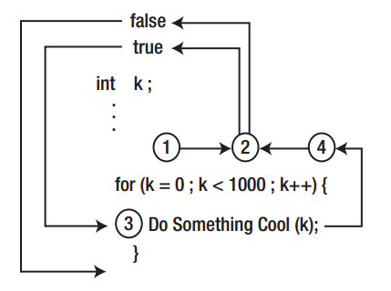
Arduino Language
Using a for Loop

Slide 40
Arduino Language
The while Loop
The second type of loop structure you will examine is the while loop. The syntax of the while loop is:
while (expression2) {
// Statements in the loop body
} // End of while statement block

Slide 41
Arduino Language
Let’s rewrite the for loop above as a while loop:
int k;
// some additional statements
k = 0; // This is expression1
while (k < 1000) { // This is expression2
DoSomethingCool();
k++; // This is expression3
} // End of the while loop

Slide 42
Arduino Language
The do-while Loop
The third type of loop structure is the do-while loop. The syntax is:
do {
// Loop body statements
} while (expression2)

Slide 43
Arduino Language
While vs Do While
int k = 1001; while (k < 1000) { DoSomethingCool(k); k++; }
int k = 1001;
do {
DoSomethingCool(k);
k++;
} while (k < 1000);

Slide 44
Arduino Language
Good rules for loops
1: Variable Initialization 2: Loop Control Test 3: Changing the Loop Control Variable’s State

Slide 45
Arduino Language
The Five Program Steps
Every program you can think of can be reduced to five basic program elements, or steps. When you first start to design a program, you should think of that program in terms of the following Five Program Steps.
Initialization Step
Input Step
Process Step
Output Step
Termination Step

Slide 46
Arduino Language
Initialization
The purpose of the Initialization Step is to establish the environment in which the program will run. Simply stated, the Initialization Step does whatever background preparation must be done before the program can begin execution to solve its primary task.

Slide 47
Arduino Language
Input
Almost every computer program has a task that is designed to take some existing state of information, process it in some way, and show the new state of that information.

Slide 48
Arduino Language
Process
The Process Step is responsible for taking a set of inputs and processing it to get a new set of data.

Slide 49
Arduino Language
Output
After the Process Step has finished its work, the new value is typically output on some display device.

Slide 50
Arduino Language
Termination
The Termination Step has the responsibility of “cleaning up” after the program is finished performing its task.

