Slide 1
ARDUINO AND MICROCONTROLLERS
Fabrizio Manzino
Mechatronics Lab
Sissa

Slide 2
Arduino Language
Functions in C
You already know what a function is, but let’s give it a formal definition. A function is a body of code designed to solve a particular task. You should think of a function as a black box, the contents of which are unknown to you. All you care about is that it addresses some task to be accomplished in your program.

Slide 3
Arduino Language
Functions in C
C is one of the few languages that doesn’t have any I/O capability built into the language. ANSI C only has 32 keywords; Arduino C has slightly less. The backbone of C is its robust library of functions.

Slide 4
Arduino Language
Functions in C
Actually, C purposely was designed to be a light language with a minimal number of keywords. Rather than bloat the language with a high keyword count, C pushes many standard language tasks off into its standard function library. The neat part about this approach is that you are not constrained by the way that the language does things.

Slide 5
Arduino Language

Slide 6
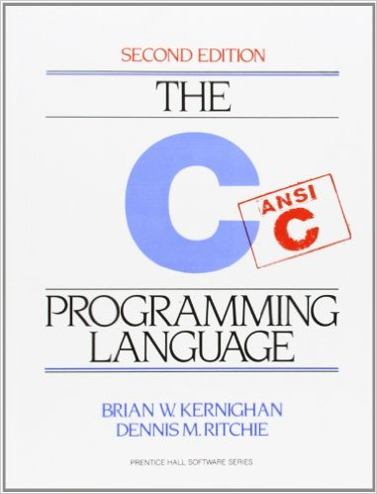
Arduino Language
A book written by the creators of the c and that explains everything.

Slide 7
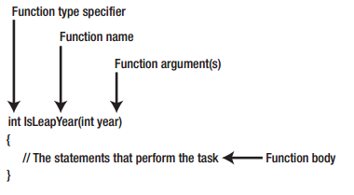
Arduino Language
The anatomy of a function.
Function Type Specifier
Function Name
Function Arguments
Function Body
Function Signature

Slide 8
Arduino Language
Function Type Specifier.
The purpose of a function type specifier is to define the type of data that is returned when the function is called. The type of data returned from the function can be whatever data type you wish (e.g., double, long, char, byte, etc.). If no value is returned from the function, then the type specifier must use the void keyword.

Slide 9
Arduino Language
Function Name.
The second part of a function is the name of the function. The choice of a function name does matter. Good function names tell you what the function does, but not necessarily how it does it.
delay(200);

Slide 10
Arduino Language
Function Arguments.
After the function name comes an opening parenthesis followed by zero or more function arguments. Function arguments are used to pass data to the function that it may need to perform its task. Multiple function arguments are delineated with commas between arguments.
digitalWrite(ledPin, LOW);

Slide 11
Arduino Language
Notes on data types.
If you tried to make the call to the standard library function named bit() using:
bit(2.33);
then the compiler complains because it knows that the argument to the function cannot be a ﬂoating point number. Catching this kind of mismatch between the type of data being sent to a function and the data type that the function expects is one form of type checking.

Slide 12
Arduino Language
Notes on data types.
The compiler also performs type checking on the value returned from a function...sort of. You could write:
int val = pow(10000, 20); //WRONG!!!
and the compiler does not complain. However, this code is wrong on two levels. First, pow() returns a “double” number and the code is trying to jam a 4-byte “double” into an “int”. Second, the numeric value computed by pow() in this example would overﬂow the maximum value an “int” can hold. The lesson here is that the Arduino C compiler performs some type checking, but some errors can slip through the cracks.

Slide 13
Arduino Language
Function Body.
The function body begins with the opening brace (“{“) that follows the closing parenthesis of the argument list and extends to the closing brace (“}”) of the function. All of the statements between these two characters comprise the function body. If the function type specifier is anything other than void, then at least one of the statements in the function body must contain the keyword return. For example:
int VolumeOfCube(int width, int length, int height)
{
int volume;
volume = width * length * height;
return volume;
}

Slide 14
Arduino Language
Function Signature.
Sometimes you may hear the term function signature when discussing functions. A function signature is comprised of everything following the type specifier through the closing parenthesis of the argument list. For example, for the VolumeOfCube() function, the function signature is:
VolumeOfCube(int width, int length, int height)
In other words, a function signature tells you the name of the function and the data it expects to be passed to it as arguments.

Slide 15
Arduino Language
Function Signature.
The function signatures are important, because you can have more than one function with the same name.
random(max)
random(min, max)
If the two functions have the same name, how does the compiler know which one to use? The compiler has no problem making that decision because the function signatures are different. Because we called the function using two arguments, the compiler knows to use the function definition that has an argument list that uses two arguments.

Slide 16
Arduino Language
Overloaded Functions.
Anytime a function has two or more different signatures, it is called an overloaded function. Technically, the C programming language does not allow overloaded functions, whereas C++ does. Because the Arduino C compiler is built on the Gnu C++ compiler, Arduino C does permit overloaded functions. This is a good thing!

Slide 17
Arduino Language
Writing Your Own Functions.
What is the first step you should do when writing your own functions? The first step should be to determine whether someone else has already written the function. A good place to start your search is
http://arduino.cc/it/Reference/Libraries.

Slide 18
Arduino Language
Passing Data Into and Back From a Function.
Understanding how data are passed back and forth between a function and the main program is important.

Slide 19
Arduino Language
Pass by Value.
When data are passed to a function using the pass-by-value mechanism, it is the value of the variable that is sent to the function, rather than the variable itself. In other words, a temporary copy of the value of the variable is copied and used in the call to the function.

Slide 20
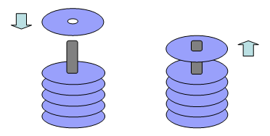
Arduino Language
The stack.
Stacks in computing architectures are regions of memory where data is added or removed in a last-in-first-out (LIFO) manner.

Slide 21
Arduino Language
Variable Scope.
The scope of a data object refers to its visibility and lifetime in a program.
In computer programming, the scope of a variable is the region of a computer program where the binding is valid: where the name can be used to refer to the variable. Such a region is referred to as a scope block. In other parts of the program the name may refer to a different entity (it may have a different binding), or to nothing at all (it may be unbound). The scope of a binding is also known as the visibility of an entity.
As a general rule, you want to restrict the access to a piece of data as much as possible.

Slide 22
Arduino Language
Variable Scope.
By the way, if you hide the data “completely,” nothing could ever change the data and the state of the program would never change, rendering the program pretty much useless. On the other hand, giving free access to the data by every element in the program makes it very difficult to determine who changed what. As a result, when a bogus value shows up, you don’t know where to look or who to blame. That is, debugging a program becomes more difficult.

Slide 23
Arduino Language
Encapsulation.
The process of restricting access to data is called encapsulation.

Slide 24
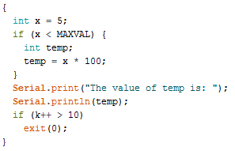
Arduino Language
Statement Block Scope
The most restrictive level of scope is the statement block scope level.

Slide 25
Arduino Language
Statement Block Scope
The error message tells us that temp is “not declared in this scope.” Stated differently, temp is “out of scope.”
What does this mean?
The problem is that we have defined temp to have statement block scope. Statement block scope means that the data item exists from the point of its definition to the end of the statement block in which it is defined. This means that temp “lives” or is “usable” from the point of its definition to the closing brace of the if statement block. Once the closing brace of the if statement is reached, temp is removed from the symbol table: temp is dead and no longer lives...it is “out of scope.”

Slide 26
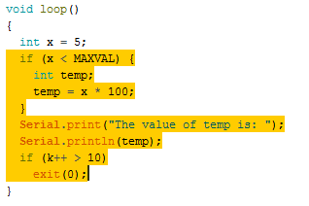
Arduino Language
Local Scope.
A variable that has local scope has life and visibility from the point of its definition to the end of the function in which it is defined.

Slide 27
Arduino Language
Local Scope.
Local scoped variables are quite common in C programs. Local scope offers some degree of encapsulation, but is not so restrictive as to render the variable useless.

Slide 28
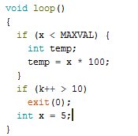
Arduino Language
Local Scope.

Slide 29
Arduino Language
Global Scope.
From time-to-time, you need a variable that is accessible by all functions within the program. If you have a piece of data that must be available everywhere in the program, then that variable should be defined with global scope. A variable has global scope if it is defined outside of a function block.

Slide 30
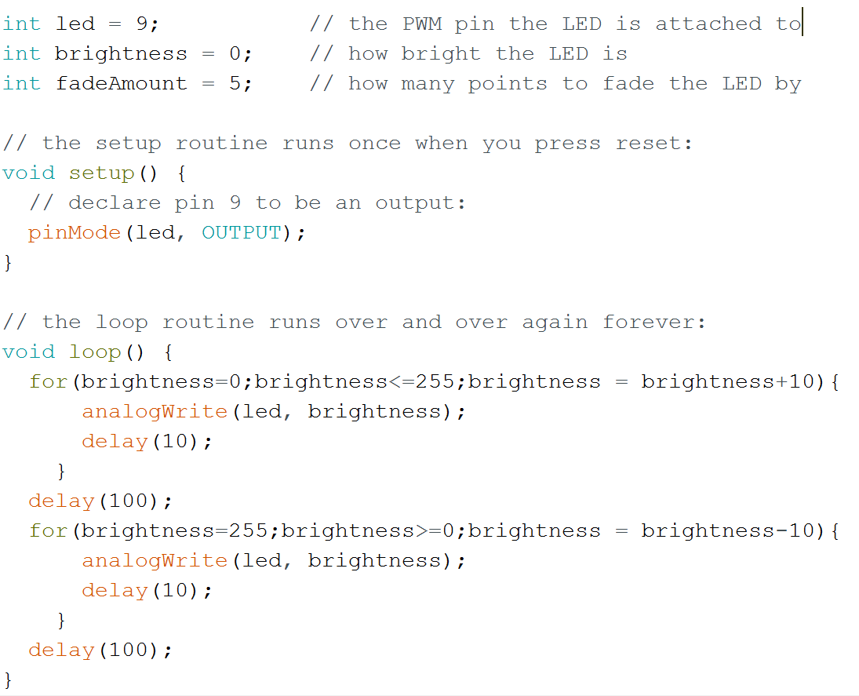
Arduino Language
Global Scope.

Slide 31
Arduino Language
Scope and Storage Classes.
Arduino C recognizes four storage classes:
Auto
Register
Static
Extern

Slide 32
Arduino Language
The auto Storage Class.
The auto storage class is the default storage class for variables with local scope. The actual impact of using an auto storage class in Arduino C appears to make no difference to the generated code and, therefore, relegates itself to a documentation feature.

Slide 33
Arduino Language
The register Storage Class.
The register storage class is used to inform the compiler that the data item should be stored in a (chip) register rather than in memory. The idea is that such a data definition would optimize the generated code for speed by keeping the variable in a register.

Slide 34
Arduino Language
The register Storage Class.
The use of the keyword register is a suggestion to the code generator not an edict. That is, the code generator makes the final decision about the fate of a variable defined with the register storage class.

Slide 35
Arduino Language
The static Storage Class.
As you know, variables with local scope die when you exit the function in which they are defined. This means that each time the function is called, a new set of local variables is created. This also means that any
values for the local variables in the function from the previous execution of the function’s code are lost.
There are, however, situations where it would be nice if you could preserve the value of a variable between function calls.

Slide 36
Arduino Language
The static Storage Class.
For example, you might like to maintain a count of the number of times a particular function is executed. That goal is not possible with variables defined with the default (auto) storage class because they are recreated each time the function is called.

Slide 37
Arduino Language
The static Storage Class.
Obviously, one solution is to move the variable of interest out of the function and define it with global scope.
This solve the problem, but is not a good solution!!!

Slide 38
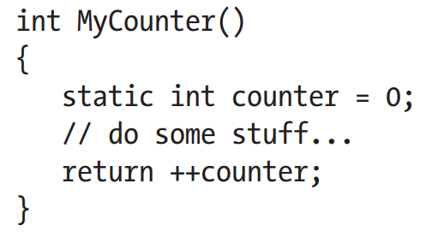
Arduino Language
The static Storage Class.

Slide 39
Arduino Language
The static Storage Class.
Using the static storage class specifier causes the compiler to generate code that preserves the value of the variable between function calls. First, the data definition of the variable is not executed each time the function is called. In fact, the variable is not generated using the stack mechanism. Rather, the variable is created when the program begins execution and is allocated in such a way that its value is maintained throughout the program’s execution. The compiler takes care of these details for you.

Slide 40
Arduino Language
The extern Storage Class.
Sometimes a project gets to the point where it makes sense to split the source code into two or more source code files. Perhaps you split the files such that those functions that are concerned with the Input Step are in one source file, whereas functions dealing with the Process Step are in another source file.

Slide 41
Arduino Language
The extern Storage Class.
The extern access specifier simply tells the compiler: “Hey this variable is not defined in this file. However, this statement does allow you to create an attribute list for the variable so you can use it in this file.”

Slide 42
Arduino Language
Name collision and scope
What if we declare two variables with the same name?

Slide 43
Arduino Language
Interrupts.
There's a great mechanism built into all Arduinos that is ideal for monitoring real-time events. This mechanism is called an Interrupt. An Interrupt's job is to make sure that the processor responds quickly to important events. When a certain signal is detected, an Interrupt (as the name suggests) interrupts whatever the processor is doing, and executes some code designed to react to whatever external stimulus is being fed to the Arduino. Once that code has wrapped up, the processor goes back to whatever it was originally doing as if nothing happened!

Slide 44
Arduino Language
Interrupts.
Recommended:
attachInterrupt(digitalPinToInterrupt(pin), ISR, mode)
Not recommend:
attachInterrupt(Interupt_Vector, Function_name, Interrupt_Mode);
attachInterrupt(pin, ISR, mode)

Slide 45
Arduino Language
Interrupt vector.
The interrupt vector determines what pin can generate an interrupt. This isn't the number of the pin itself - it's actually a reference to where in memory the Arduino processor has to look to see if an interrupt occurs. A given space in that vector corresponds to a specific external pin, and not all pins can generate an interrupt!
On the Arduino Uno, pins 2 and 3 are capable of generating interrupts, and they correspond to interrupt vectors 0 and 1, respectively.

Slide 46
Arduino Language
Function Name.
The function name of the interrupt service routine - this determines the code that gets run when the interrupt condition is met.

Slide 47
Arduino Language
Interrupt mode.
The interrupt mode determines what pin action triggers an interrupt.
The Arduino Uno supports four interrupt modes :
RISING : activates an interrupt on a rising edge of the interrupt pin
FALLING : activates on a falling edge
CHANGE : responds to any change in the interrupt pin's value
LOW : triggers any time the pin is a digital low.

Slide 48
Arduino Language
Interrupts.
There are a few important things to consider when writing an interrupt service routine :
Interrupt function code should be short and sweet. You don't want to derail the main loop for too long!
There are no input variables or returned values. All changes have to be made on global variables.

Slide 49
Arduino Language
Interrupts.
Example:
Measure time

Slide 50
Arduino Language
What’s a stepper Motor.
A stepper motor or step motor or stepping motor is a brushless DC electric motor that divides a full rotation into a number of equal steps. The motor's position can then be commanded to move and hold at one of these steps without any feedback sensor (an open-loop controller), as long as the motor is carefully sized to the application in respect to torque and speed.

Slide 51
Arduino Language
What’s a stepper Motor.

