Slide 1
ARDUINO AND MICROCONTROLLERS
Fabrizio Manzino
Mechatronics Lab
CyNexo

Slide 2
Arduino Registers
Registers
Registers are nothing more than storage containers for data inside a processor or microcontroller, and for many microcontrollers (like the ATmega328P), they share the same space with SRAM.

Slide 3
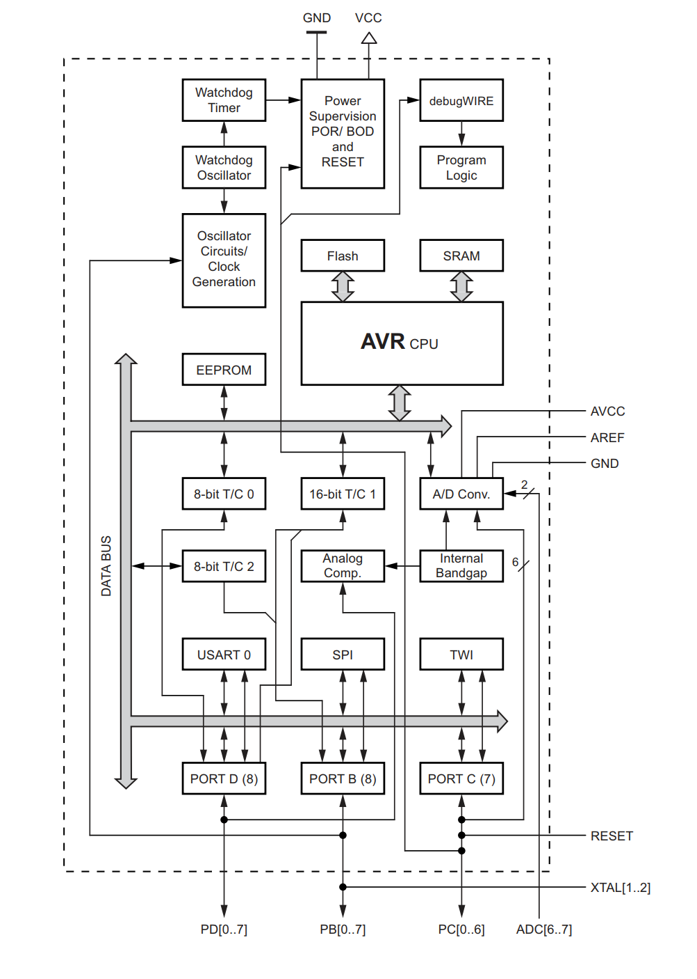
Arduino Registers
Arduino Memory

Slide 4
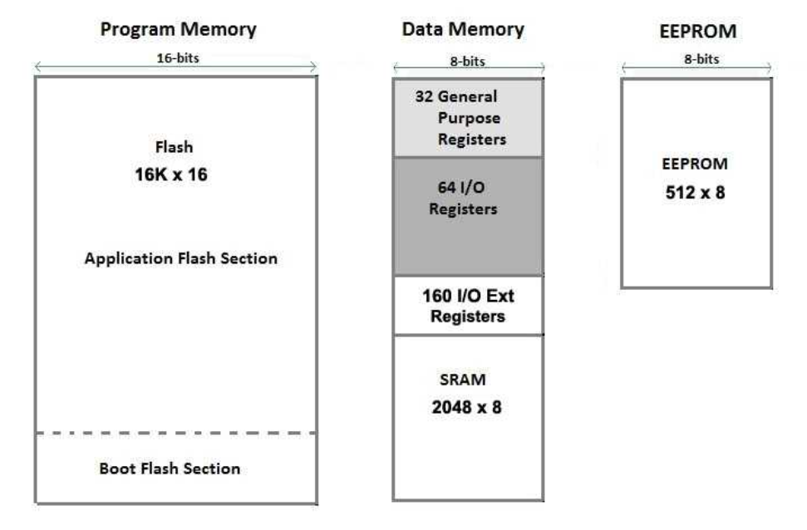
Arduino Registers
Arduino Memory

Slide 5
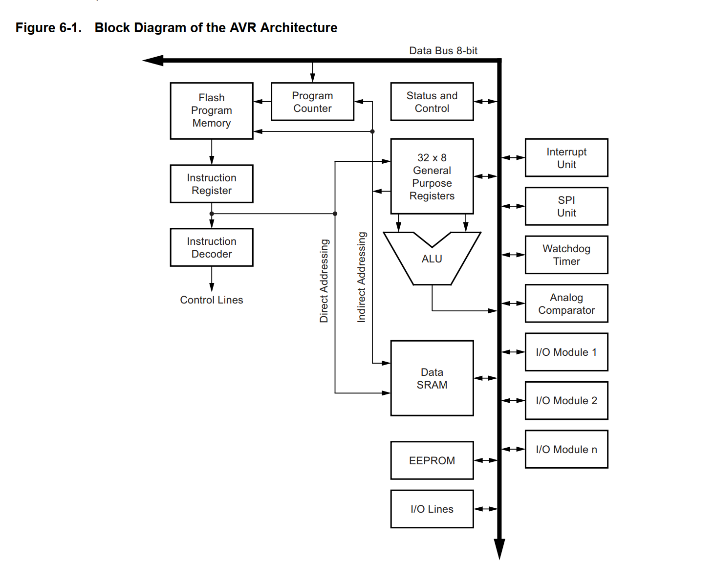
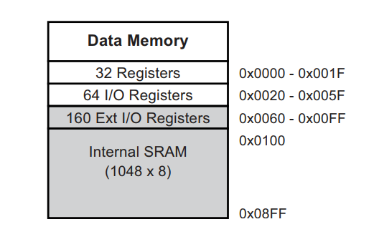
Arduino Registers
Registers
Notes:
Generic registers -> just a small memory close to ALU
Specific Registers -> every single bit have a meaning

Slide 6
Arduino Registers
Registers

Slide 7
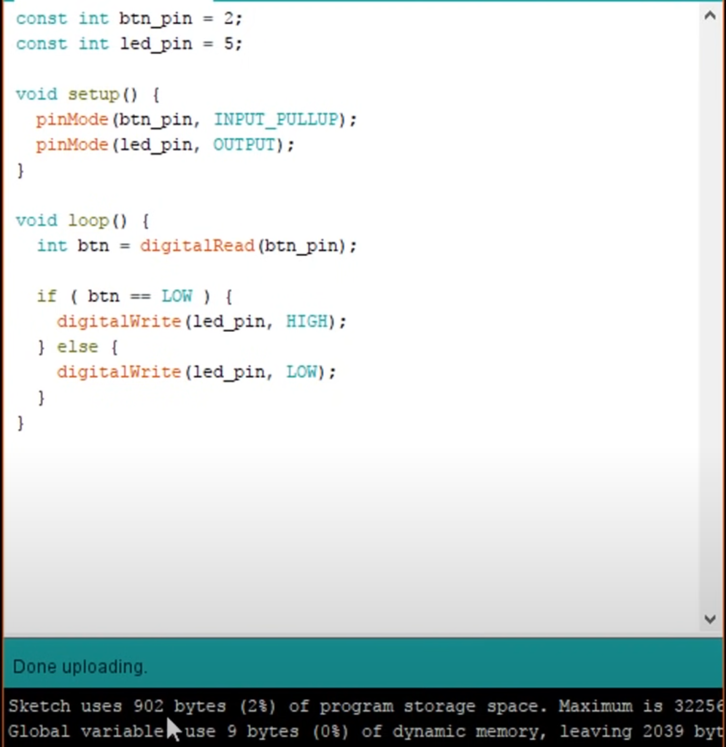
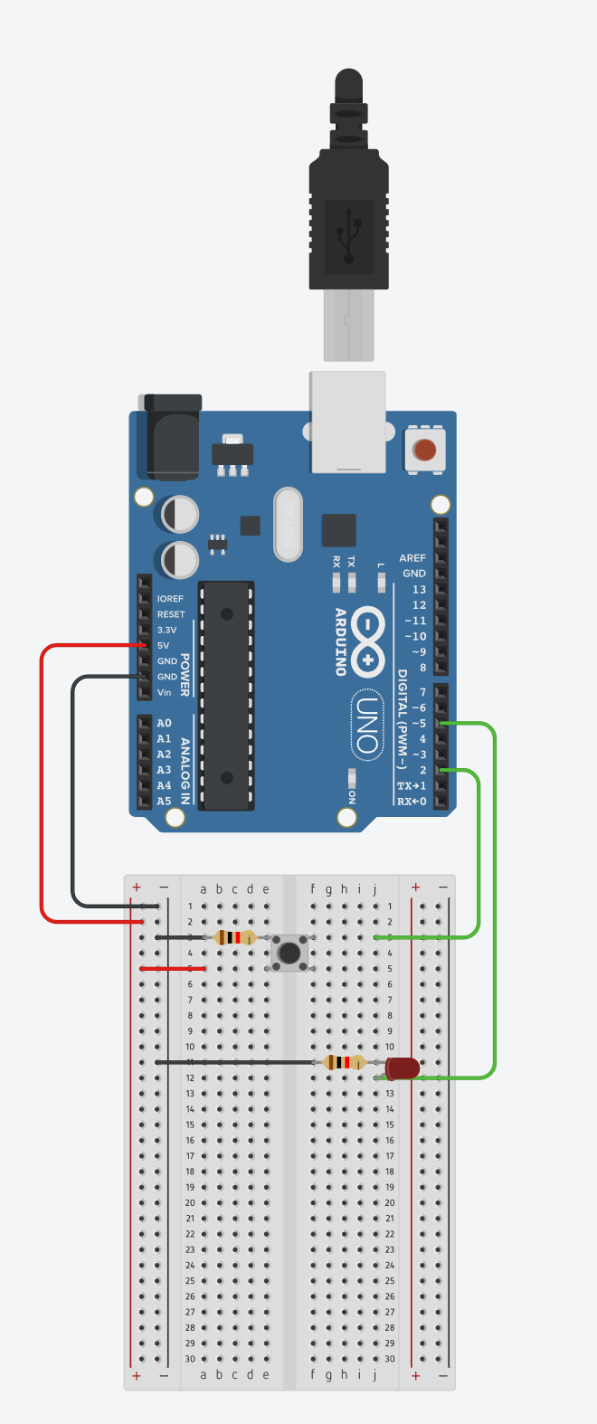
Arduino Registers
Registers

Slide 8
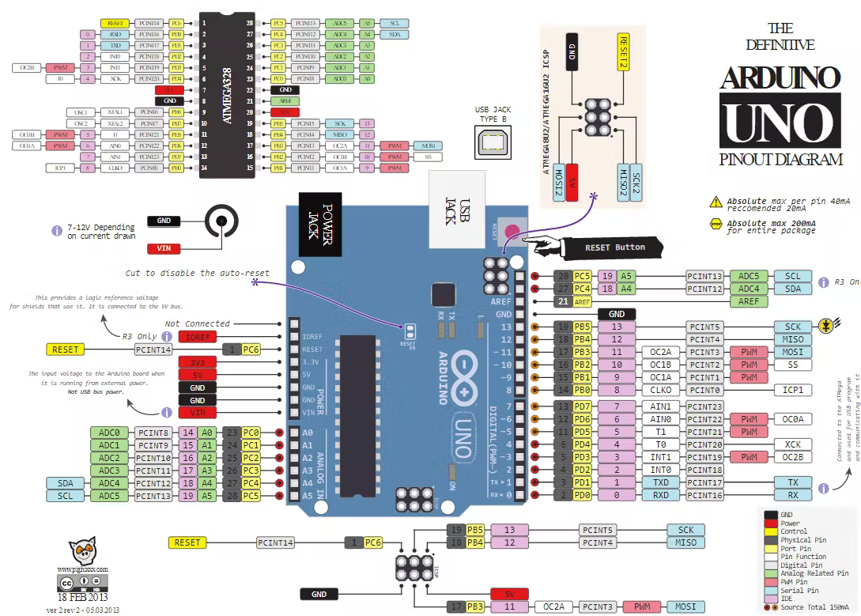
Arduino Registers

Slide 9
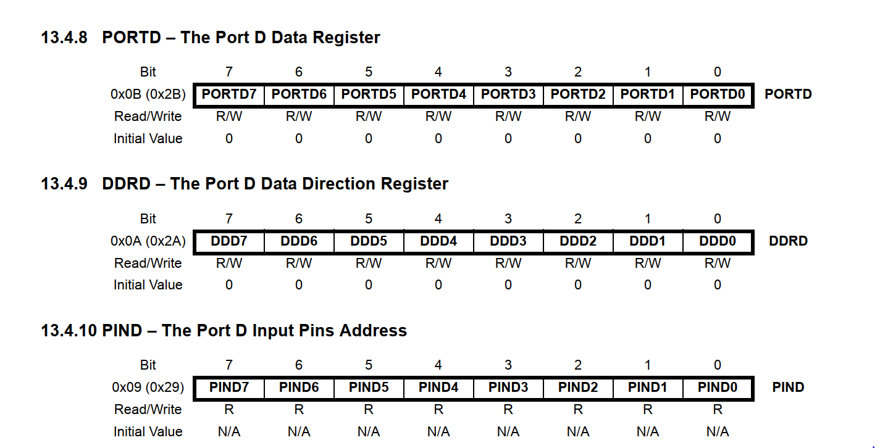
Arduino Registers
Notes:
Pag 73 ATMega328P

Slide 10
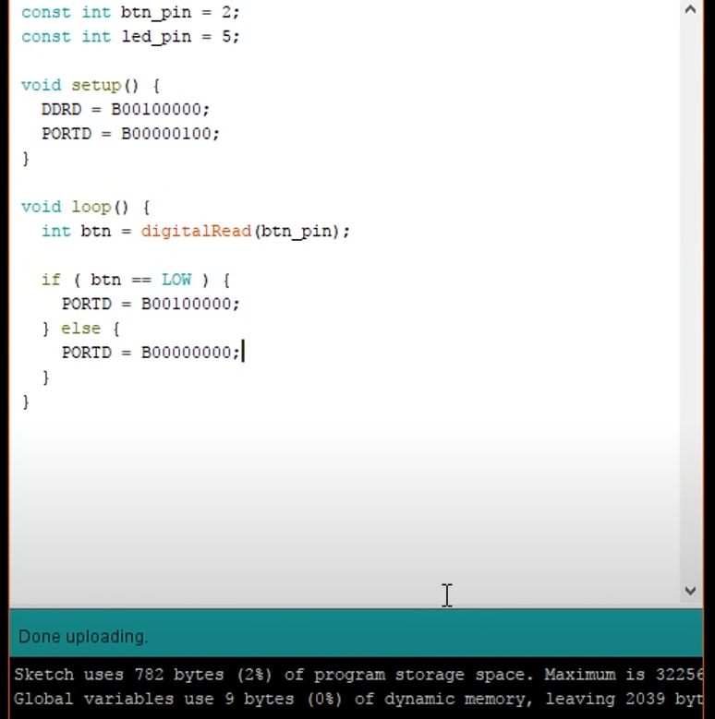
Arduino Registers
Registers

Slide 11
Arduino Registers
Bit Manipulation : How to set a Bit
0
0
1
0
0
0
0
0
( 1 << 5 )
0
0
0
0
0
1
0
0
PORTD
0
0
1
0
0
1
0
0
Bitwise OR
(1 << 5) | PORTD

Slide 12
Arduino Registers
Bit Manipulation : How to reset a Bit
1
1
0
1
1
1
1
1
~( 1 << 5 )
0
0
0
0
0
1
0
0
PORTD
0
0
0
0
0
1
0
0
Bitwise and
(1 << 5) & PORTD

Slide 13
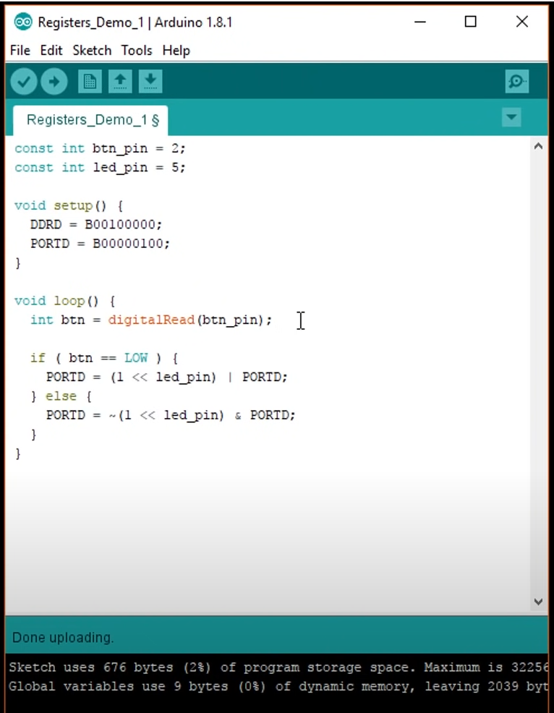
Arduino Registers
Registers

Slide 14
Arduino Registers
Bit Manipulation : How to reset a Bit
0
0
0
0
0
1
0
0
( 1 << 2 )
x
x
x
x
x
x
x
x
PIND
0
0
0
0
0
x
0
0
Bitwise and
0
0
0
0
0
0
0
x
>> 2
(1 << 5) & PORTD

Slide 15
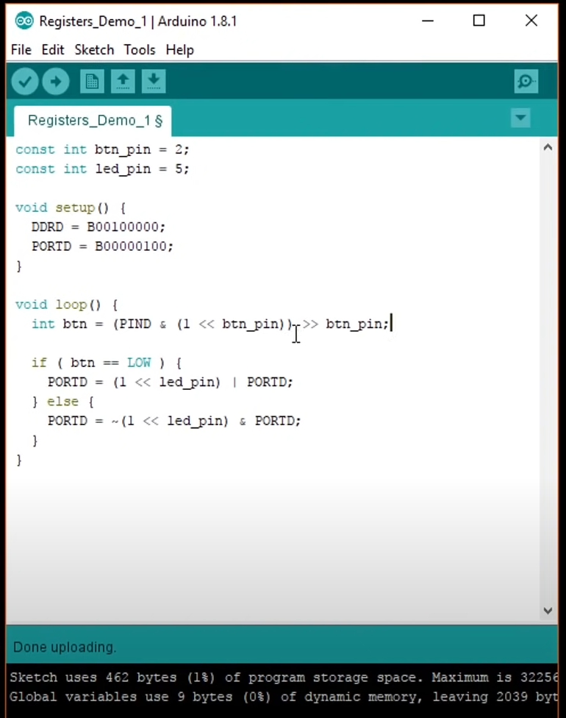
Arduino Registers
Registers

Slide 16
Arduino Registers

Slide 17
Arduino TIMERS
TIMER
Timer is a specialized type of clock used for measuring specific time intervals

Slide 18
Arduino TIMERS
Arduino UNO have 3 TIMERS
Timer0
The timer0 is an 8-bit counter and is used by arduino for timing functions such as delay or millis. So when using the Arduino environment it is best not to use the timer0.
Timer1
Timer1 is 16bit and can count up to a maximum of 65535. The Arduino servo library uses this timer.
Timer2
Timer2 is 8-bit and is used by the “tone” command.

Slide 19
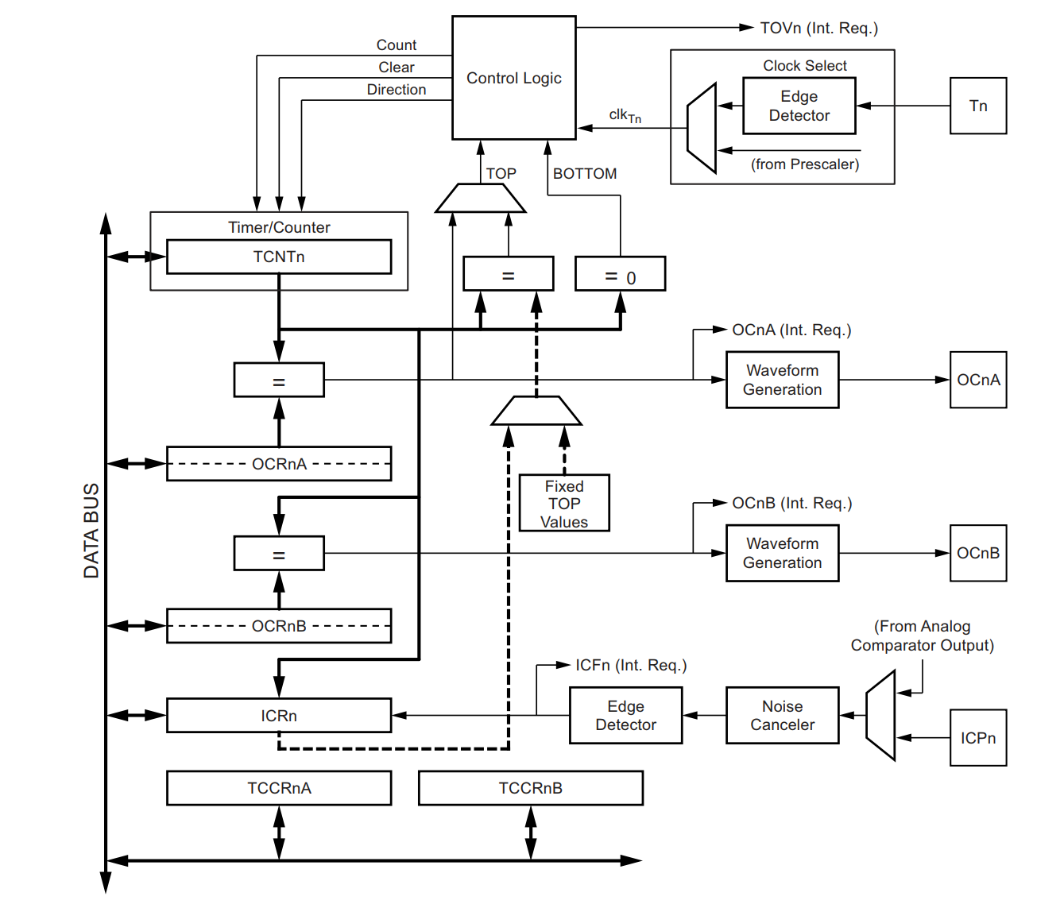
Arduino TIMERS
TIMERS are configured using special registers dedicated to each timer
TCNT1 : Registers in which the count is contained
OCR1A : Value of the count we want to achieve
TCCR1A : Timer settings

Slide 20
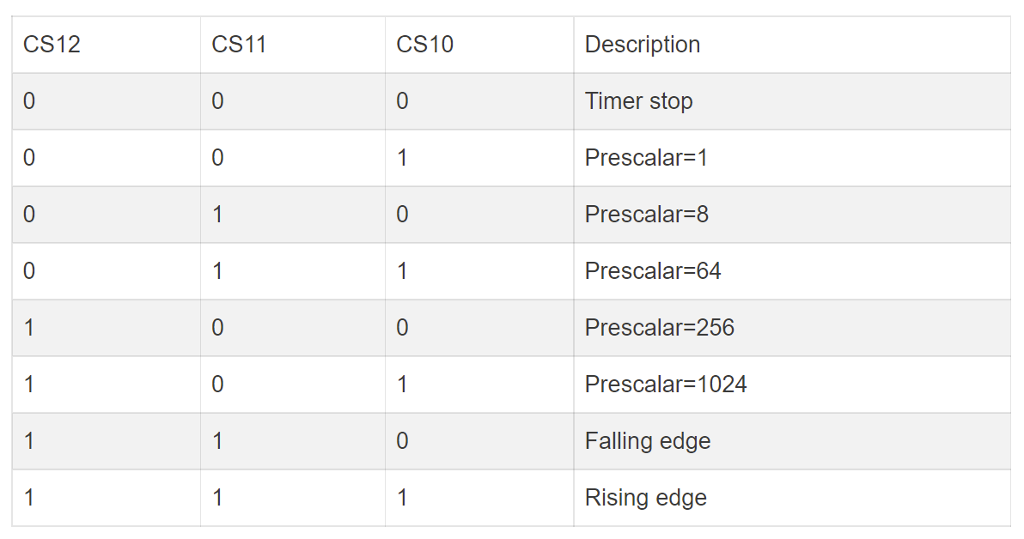
Arduino TIMERS
TCCR1A is the Timer1 Control Register
the bits for CS12, CS11 and CS10 respectively to set a prescalar value.

Slide 21
Arduino TIMERS
Prescaler
A prescaler is an electronic counting circuit used to reduce a high frequency electrical signal to a lower frequency by integer division. ... The purpose of the prescaler is to allow the timer to be clocked at the rate a user desires

Slide 22
Arduino Language
Introduction to Pointers.
One of the most powerful features of C is pointers. Because of the raw power of pointers, many popular languages either don’t support pointers at all (e.g., Java) or only let you use them in a very limited way.

Slide 23
Arduino Language
Variables.
Int Variable1 = 10;
Int Variable2 = 10;
Value of Variable 1
Value of Variable 2
Value of Variable 3
Value of Variable 4
Value of Variable 5
…
…
…

Slide 24
Arduino Language
Variables.
All variables have three «components» :
A data Type
A value
A place in memory, where the value is stored

Slide 25
Arduino Language
Variables.
Int Variable1 = 10;
Value of Variable 1
Value of Variable 2
Value of Variable 3
Value of Variable 4
Value of Variable 5
…
…
…

Slide 26
Arduino Language
What’s a pointer?
In computer science, a pointer is a programming language object, whose value refers to (or "points to") another value stored elsewhere in the computer memory using its memory address. A pointer references a location in memory, and obtaining the value stored at that location is known as dereferencing the pointer.

Slide 27
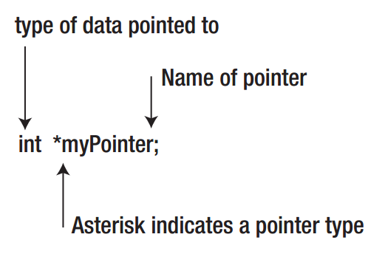
Arduino Language
The syntax for a pointer definition is :

Slide 28
Arduino Language
Pointer Name
A pointer is just a variable, so there are no special rules for naming. A good idea is to use something like this :
ptrName
It is not imperative that you begin pointer variables with ptr, but it doesn’t hurt to let everyone know that this is a pointer variable.

Slide 29
Arduino Language
Pointer Type Specifiers.
From an operational point of view, the type specifier for the pointer is the most critical part of the definition. For example, the int type specifier tells the compiler that this pointer will only be used with int data types. While the syntax rules allow you to use an int pointer with a different type of data, doing so usually results in a disaster.

Slide 30
Arduino Language
Pointer Type.
Because the amount of SRAM is less than 65K (i.e., the maximum value for a 2-byte unsigned integer), it only takes 2 bytes to store a memory address for the program’s data.
This is why each pointer variable requires the same amount of storage, regardless of the pointer’s type specifier: all pointer variables hold exactly the same type of data—a memory address.

Slide 31
Arduino Language
Pointer Type.
If you use pointers correctly, then a valid pointer can hold only one of two things:
A memory address
The value null. If a pointer holds the value “null”, then the pointer does not point to valid data.

Slide 32
Arduino Language
Pointer Type.
If you are worried about the random junk the pointer contains, you could define and initialize the pointer as part of its definition, as in:
int *ptrNumber = NULL;
This makes it clear that the pointer does not point to valid data.
Important : #include <stdio.h>

Slide 33
Arduino Language
Pointer Type.
Now that we know how to define a pointer let’s actually try to use it.
int number = 5;
int *ptrNumber;
ptrNumber = &number;
What is “&” ?

Slide 34
Arduino Language
Address of operator (&).
The purpose of the “address of operator” (&) is to tell the compiler:
“Don’t do the standard value assignment in this assignment. Instead, take the address of the variable number and copy it into the variable ptrNumber.”

Slide 35
Arduino Language
The Indirection Operator (*).
If you wish to use a pointer to change the value of the variable it points to, then you use the indirection operator. The syntax is:
*variableID = expression1;
For example:
*ptrNumber = 10;

Slide 36
Arduino Language
Why Are Pointers Useful?
Pass value by reference to a function
Create and manipulate complex data structure

Slide 37
Arduino Language
Communication protocols.
In telecommunications, a communication protocol is a system of rules that allow two or more entities of a communications system to transmit information via any kind of variation of a physical quantity. These are the rules or standard that defines the syntax, semantics and synchronization of communication and possible error recovery methods. Protocols may be implemented by hardware, software, or a combination of both.

Slide 38
Arduino Language
Communicating systems.
The information exchanged between devices through a network, or other media is governed by rules and conventions that can be set out in technical specifications called communications protocol standards. The nature of a communication, the actual data exchanged and any state-dependent behaviors, is defined by these specifications.

Slide 39
Arduino Language
An example.
Network communications :
Your internet connection
Your phone mobile connection
Sensors Network
Your car sensors
Your wearable sensors

Slide 40
Arduino Language
How can we describe a communication protocol?
A standard way to describe communication protocols is OSI model :
Open Systems Interconnection model

Slide 41
Arduino Language
Open Systems Interconnection model.
The Open Systems Interconnection model (OSI model) is a conceptual model that characterizes and standardizes the communication functions of a telecommunication or computing system without regard to their underlying internal structure and technology. Its goal is the interoperability of diverse communication systems with standard protocols. The model partitions a communication system into abstraction layers.

Slide 42
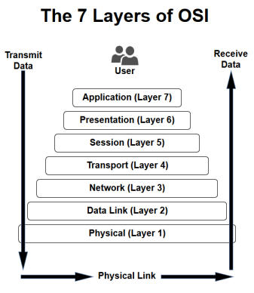
Arduino Language
Open Systems Interconnection model.

Slide 43
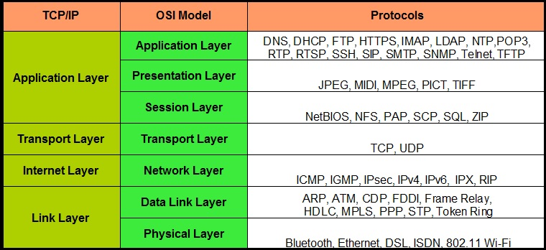
Arduino Language
Open Systems Interconnection model.

Slide 44
Arduino Language
Protocols.
1-Wire Protocol
4-20mA Current Loops
AT Protocol
AXI Bus
Bluetooth
CAN Protocol
Ethernet Protocol
I2C Protocol
IO-Link Protocol
LIN Protocol
LON (ANSI709.2) Communication Protocol
Modbus Protocol
MQ Telemetry Transport (MQTT)
NMEA Protocol
PCI Express (PCIe)
expand child menu
Power Line Protocols
RS-232 Protocol
RS-485 Protocol
SDQ Protocol
SMBus
SPI Protocol
UART Protocol
USB Protocol
expand child menu
Z-Wave

Slide 45
Arduino Language
SPI PROTOCOL.
The Serial Peripheral Interface bus (SPI) is a synchronous serial communication interface specification used for short distance communication, primarily in embedded systems. The interface was developed by Motorola in the late eighties and has become a de facto standard.

Slide 46
Arduino Language
SPI PROTOCOL.
SPI devices communicate in full duplex mode using a master-slave architecture with a single master. The master device originates the frame for reading and writing. Multiple slave devices are supported through selection with individual slave select (SS) lines.

Slide 47
Arduino Language
SPI PROTOCOL.
Typically there are three lines common to all the devices:
MISO (Master In Slave Out) - The Slave line for sending data to the master,
MOSI (Master Out Slave In) - The Master line for sending data to the peripherals,
SCK (Serial Clock) - The clock pulses which synchronize data transmission generated by the master
And one for each device
SS (Slave Select) - the pin on each device that the master can use to enable and disable specific devices.

Slide 48
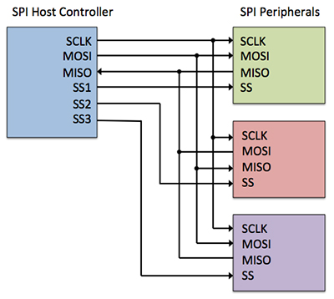
Arduino Language
SPI PROTOCOL.

Slide 49
Arduino Language
SPI PROTOCOL.
To begin communication, the bus master configures the clock, using a frequency supported by the slave device, typically up to a few MHz. The master then selects the slave device with a logic level 0 on the select line. If a waiting period is required, such as for analog-to-digital conversion, the master must wait for at least that period of time before issuing clock cycles.
During each SPI clock cycle, a full duplex data transmission occurs. The master sends a bit on the MOSI line and the slave reads it, while the slave sends a bit on the MISO line and the master reads it. This sequence is maintained even when only one-directional data transfer is intended

Slide 50
Arduino Language
Arduino SPI.
In Arduino we have a ready to use library for SPI communication.
https://www.arduino.cc/en/reference/SPI

Slide 51
Arduino Language
SPI PROTOCOL EXAMPLE.
We want an Arduino Master connected with a button and a LED.
An Arduino slave connected with an LED.
The Arduino Master read the status button and when there is a change, it sends a message to the slave that changes according to the state the led.
Every five seconds, the Master asks the slave the state of its LED and sets its led in the same way.

Slide 52
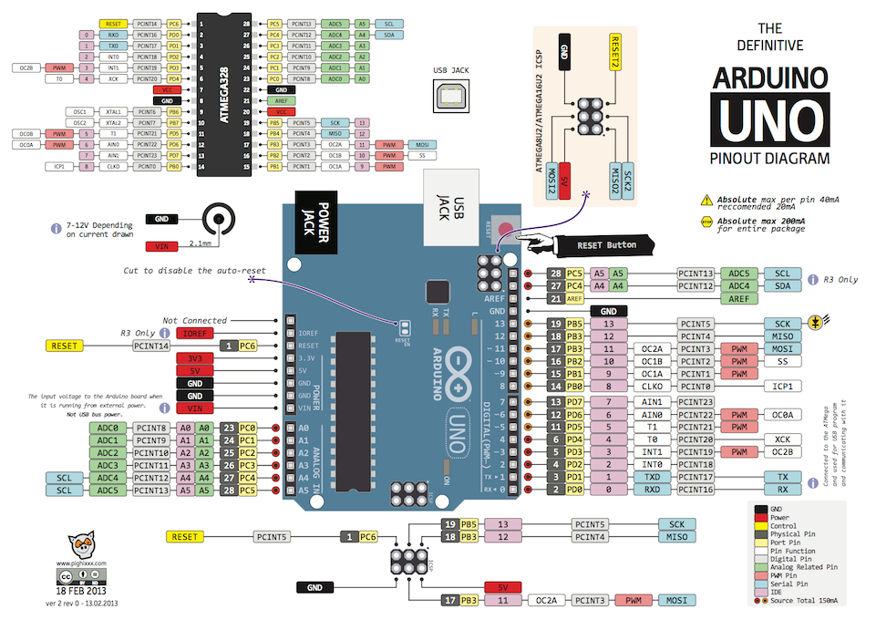
Arduino Language

Slide 53
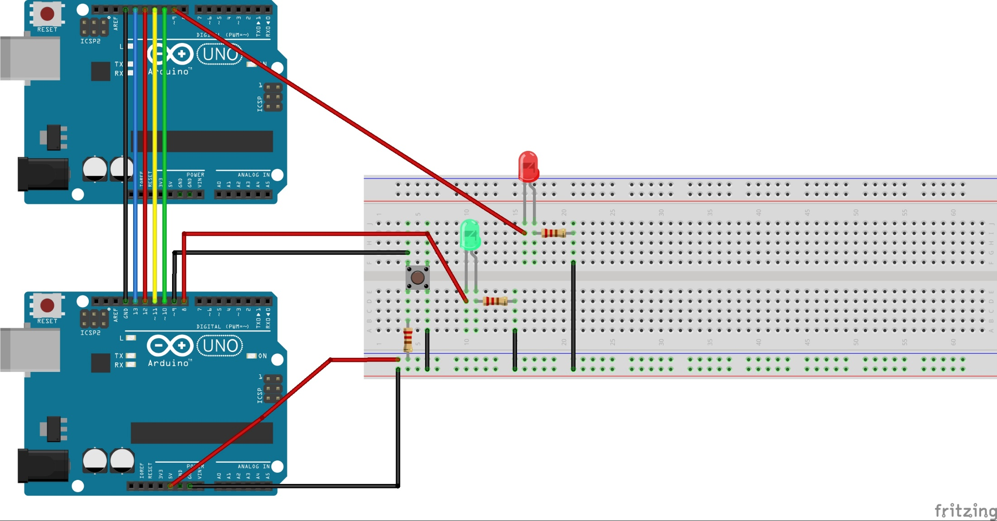
Arduino Language

Slide 54
Arduino Language
Temperature Sensor.
Select the sensor that fit your requirement
Check how to use it in a correct way
Look for sample code
Test it

